Slide 1



TERMS OF USE
This resource and its content is copyright of Elsa-Support Ltd.
©Elsa-Support 2021. All rights reserved.
All free products on this site are subject to a Creative Commons Copyright Licence. You are free to copy, distribute, display, and perform the work under the following conditions:
Attribution: You must give the original author credit - that is Elsa-Support, and our copyright labels must remain on the resource.
Non-Commercial: You may not use this work for commercial purposes. You cannot sell this work or use it for financial gain.
No Derivative Works: You may not alter, transform, or build upon this work. You must not change our work in anyway.
Thank you for abiding by copyright law.
www.elsa-support.co.uk

Slide 2

Other resources you will LOVE!
Please click the image to take you to this related and relevant resource:
www.elsa-support.co.uk

Slide 3


Slide 4
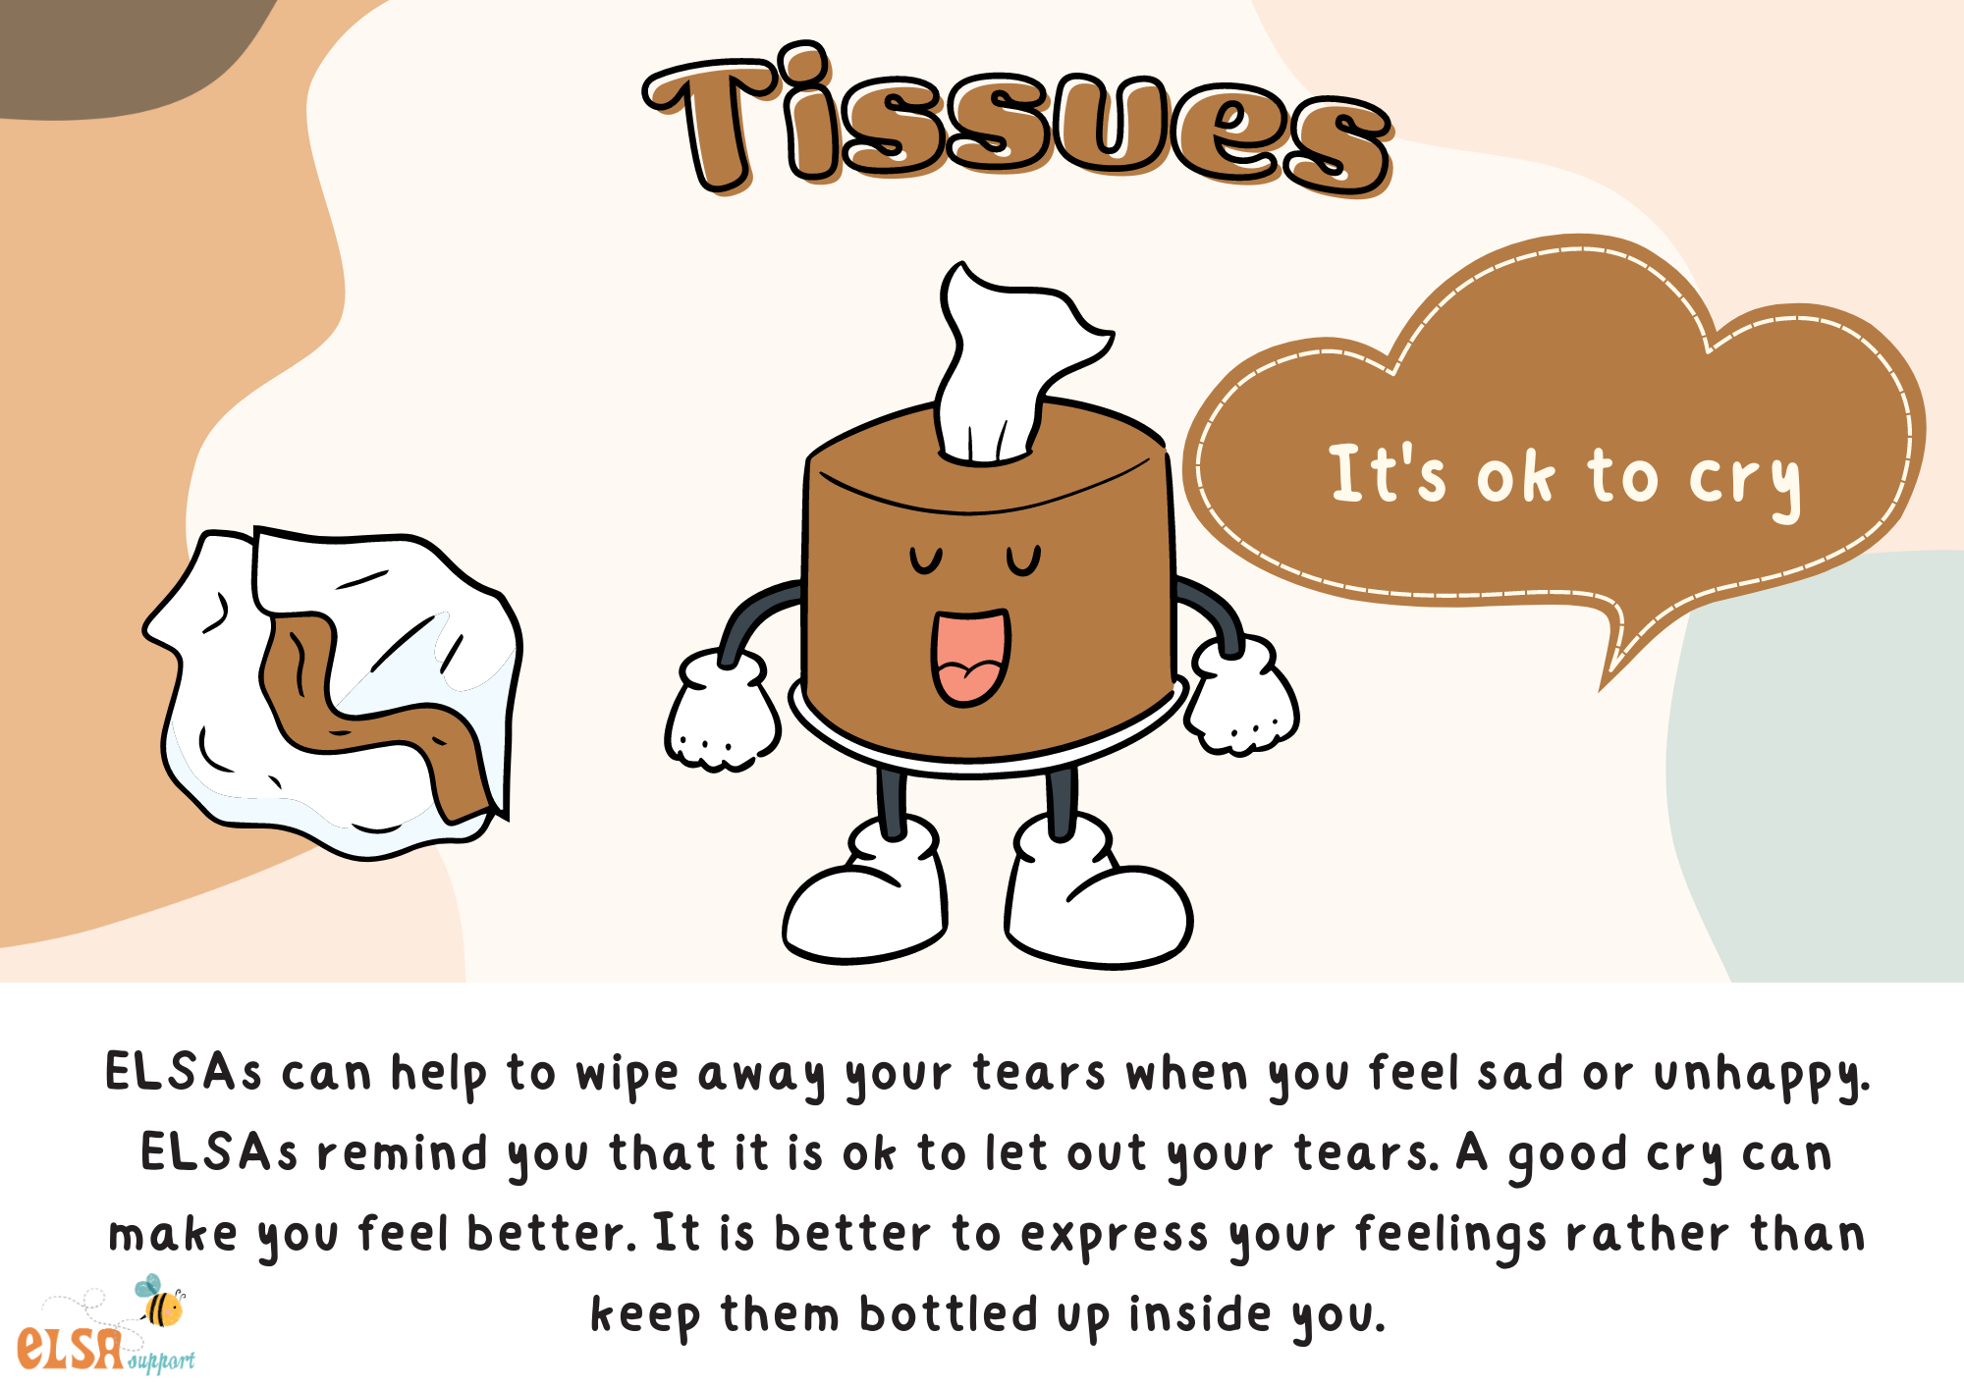

Slide 5
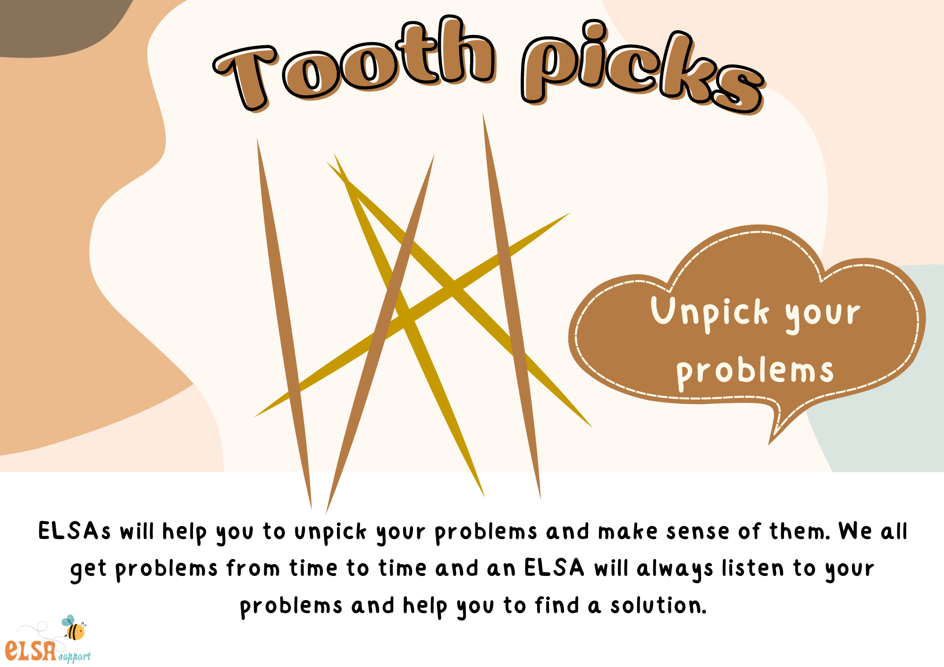

Slide 6
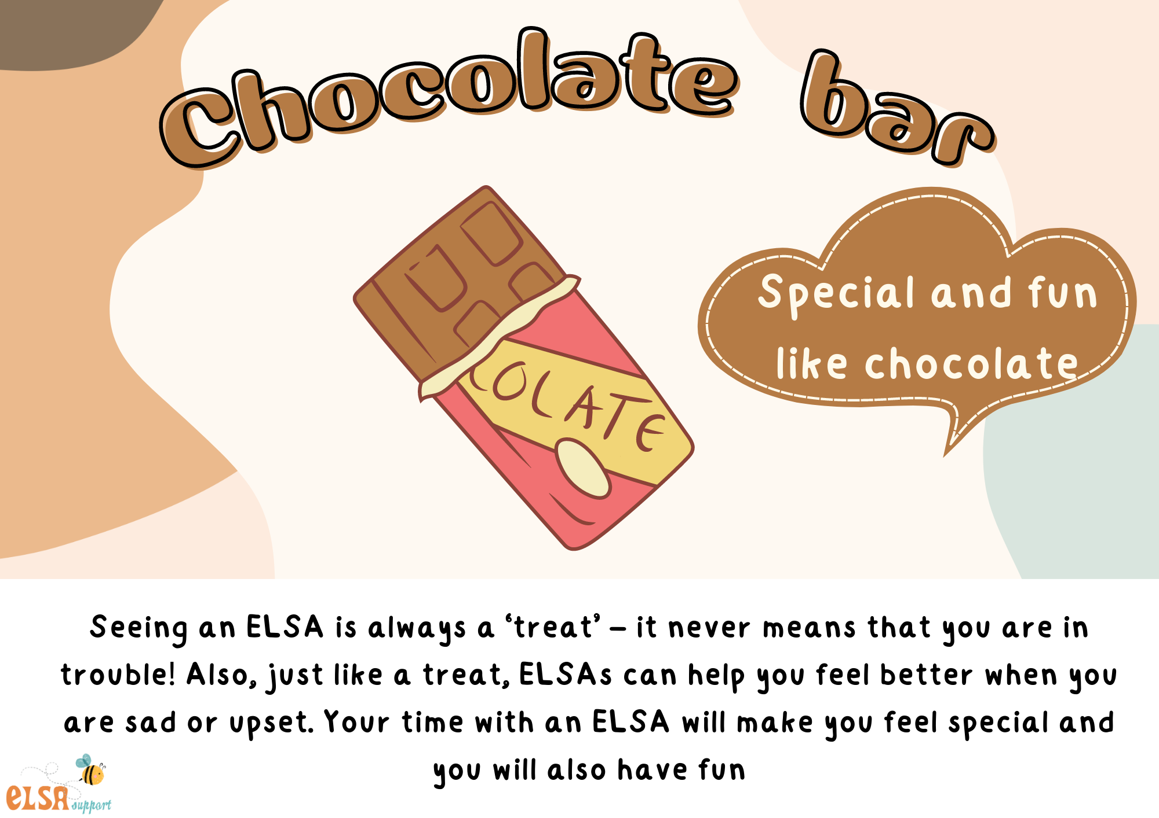

Slide 7
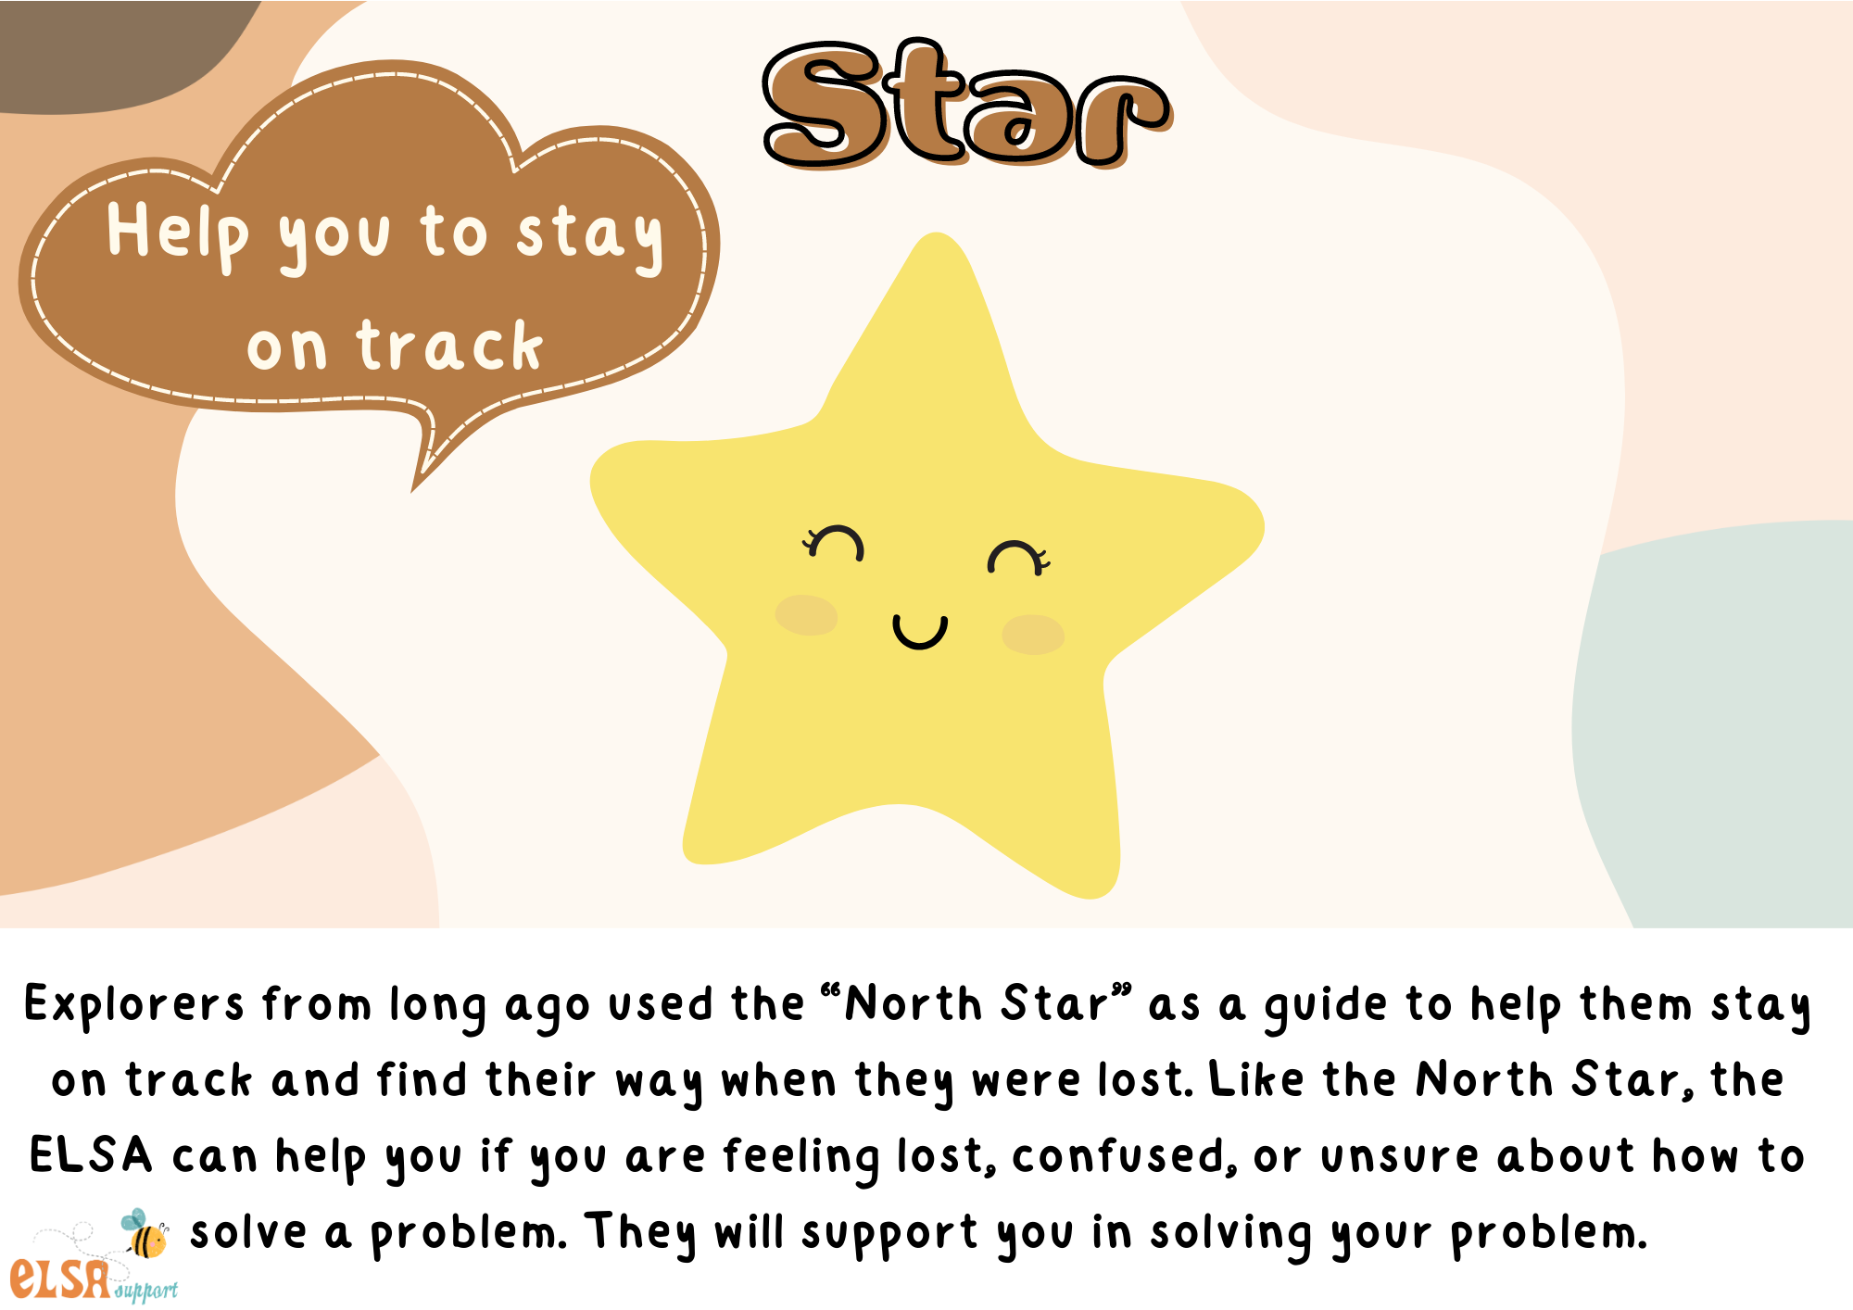

Slide 8
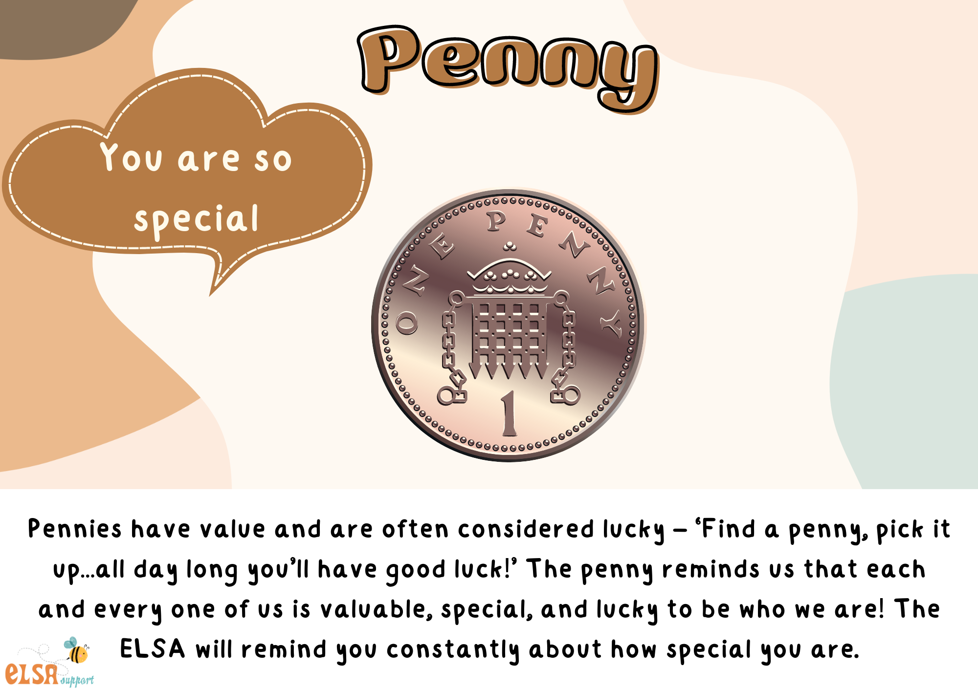

Slide 9
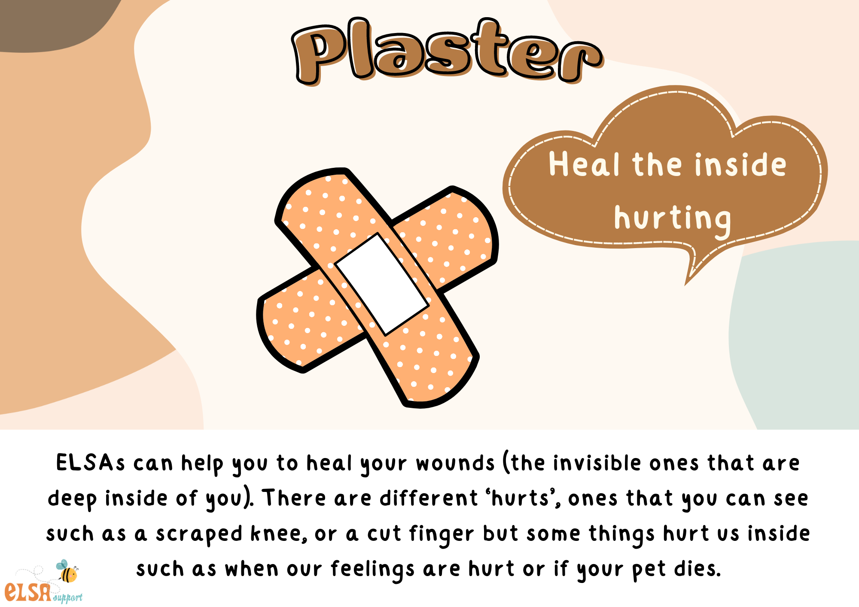

Slide 10


Slide 11
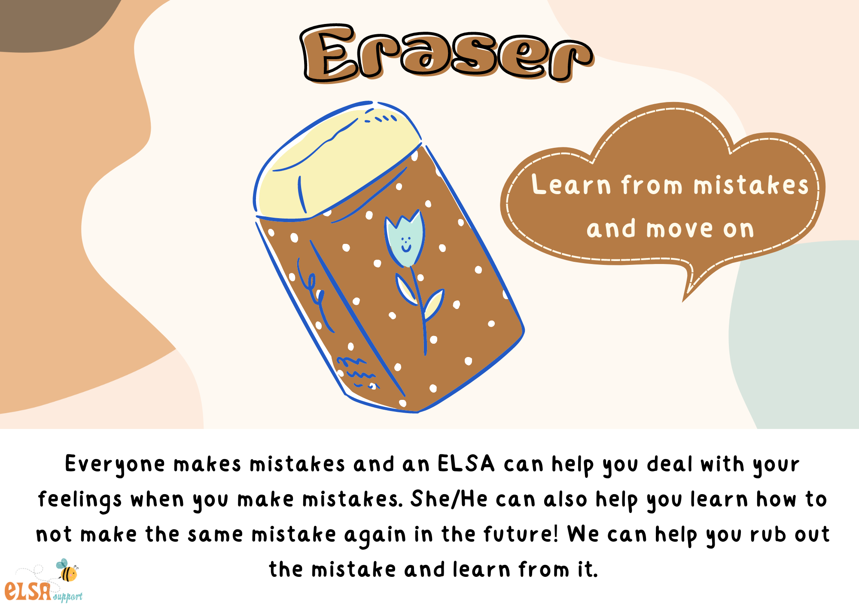

Slide 12


Slide 13
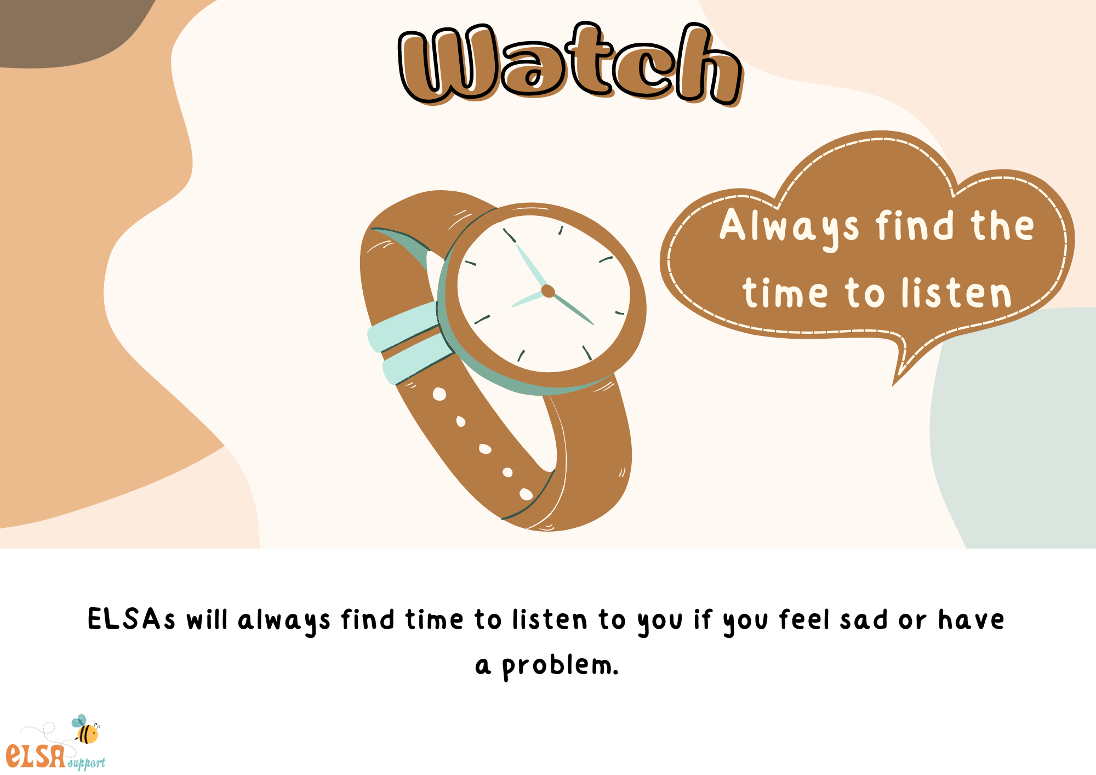

Slide 14


Slide 15
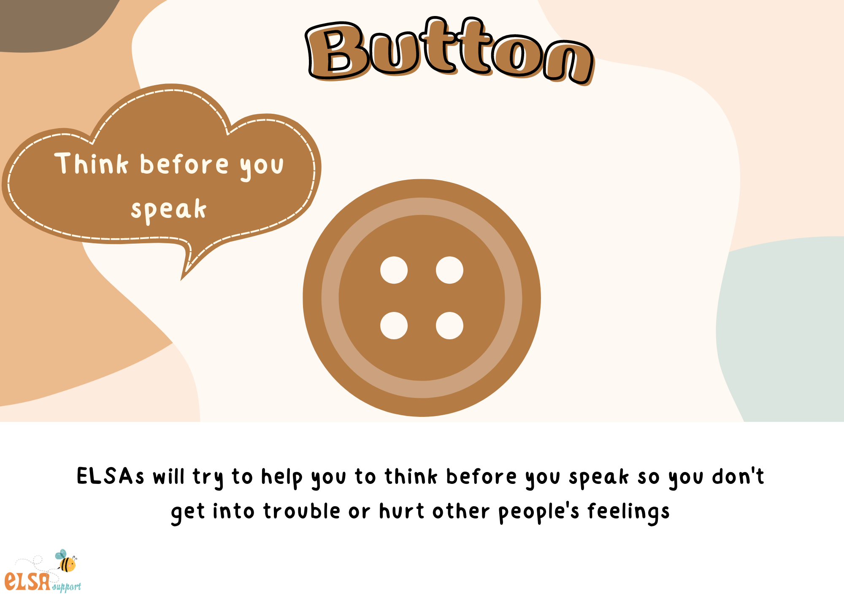

Slide 16
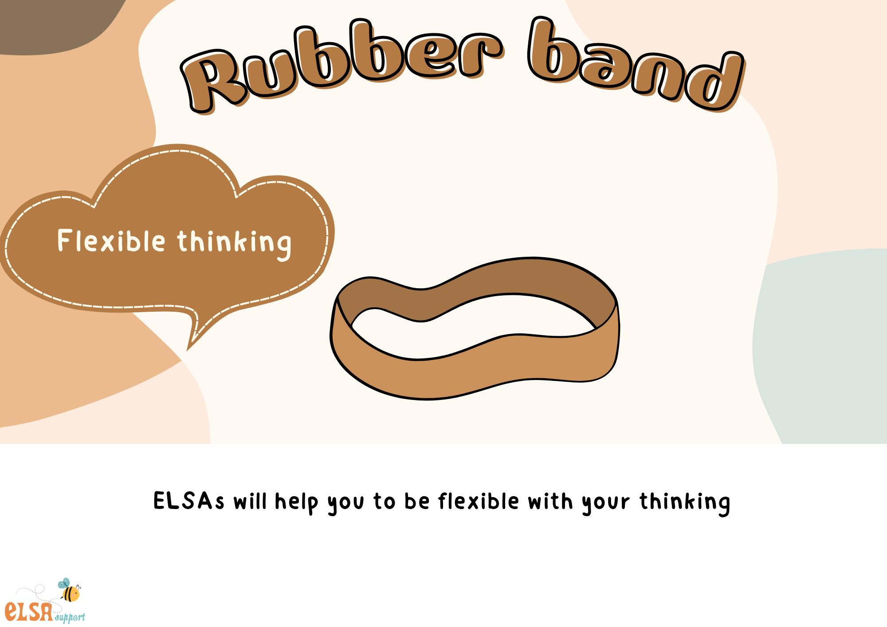

Slide 17
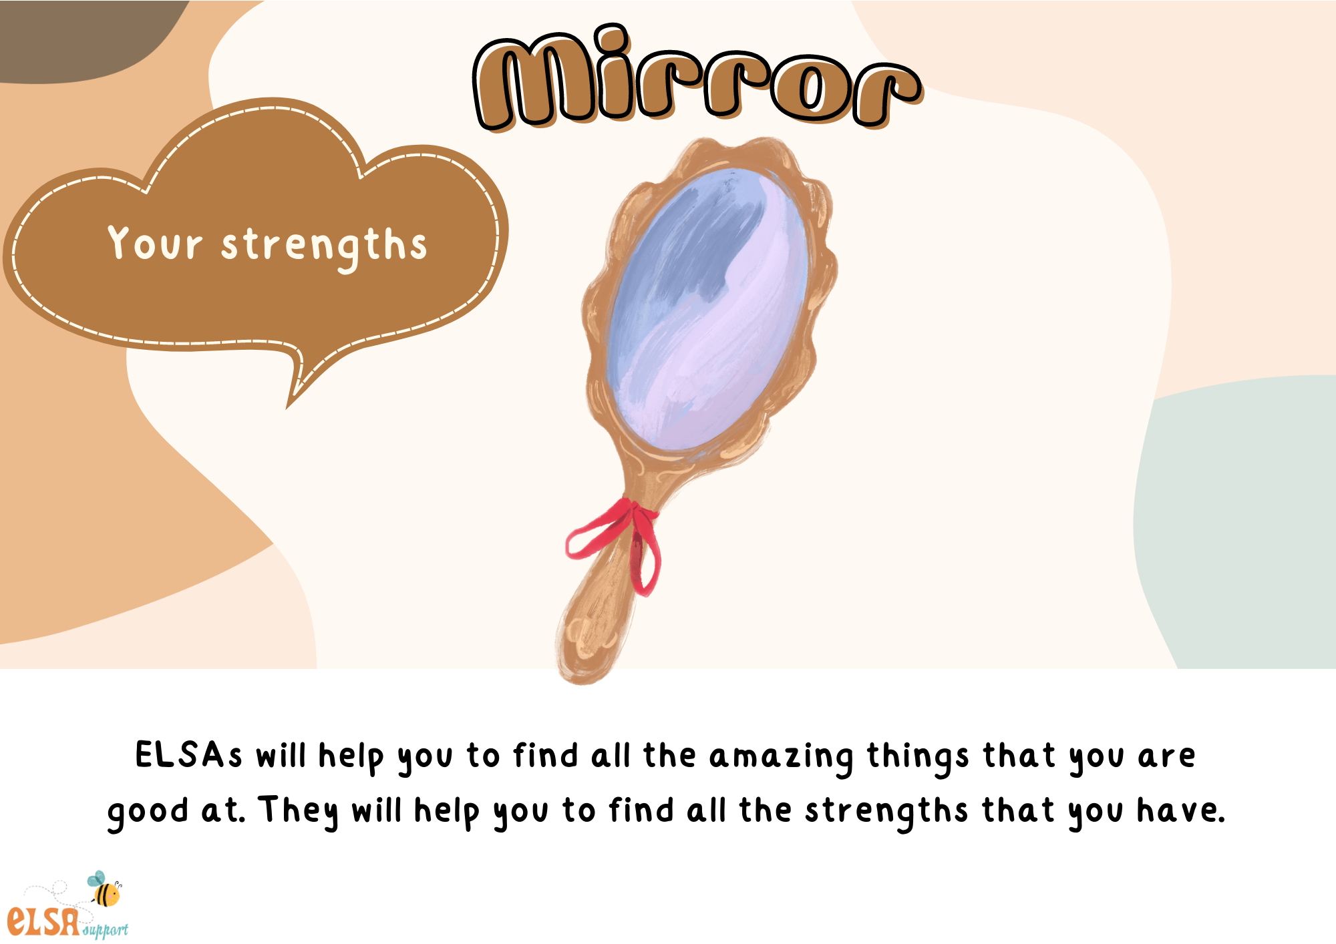

Slide 18
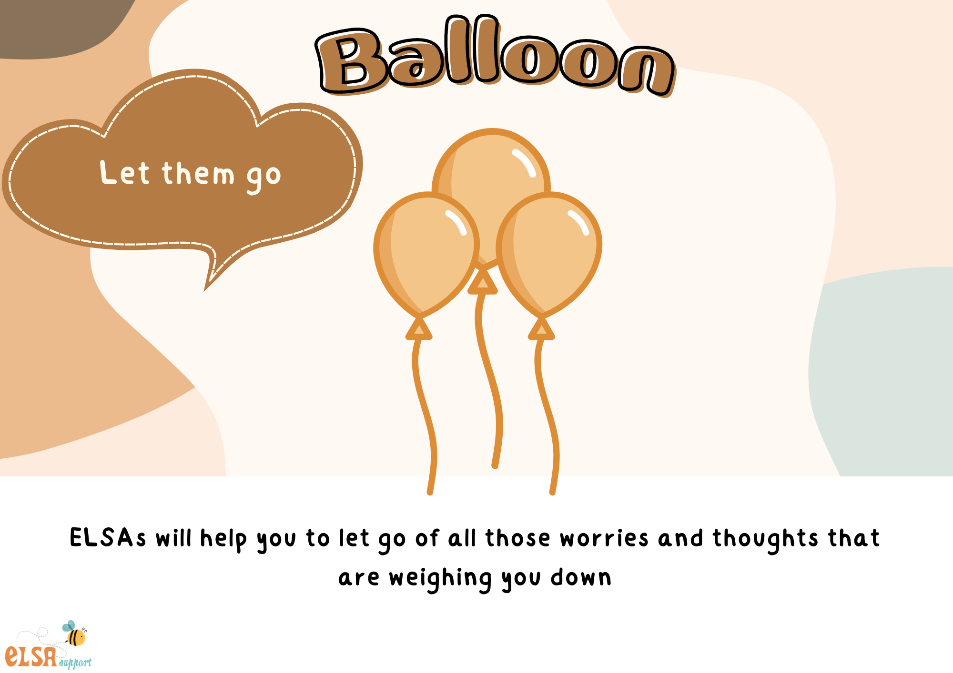

Slide 19
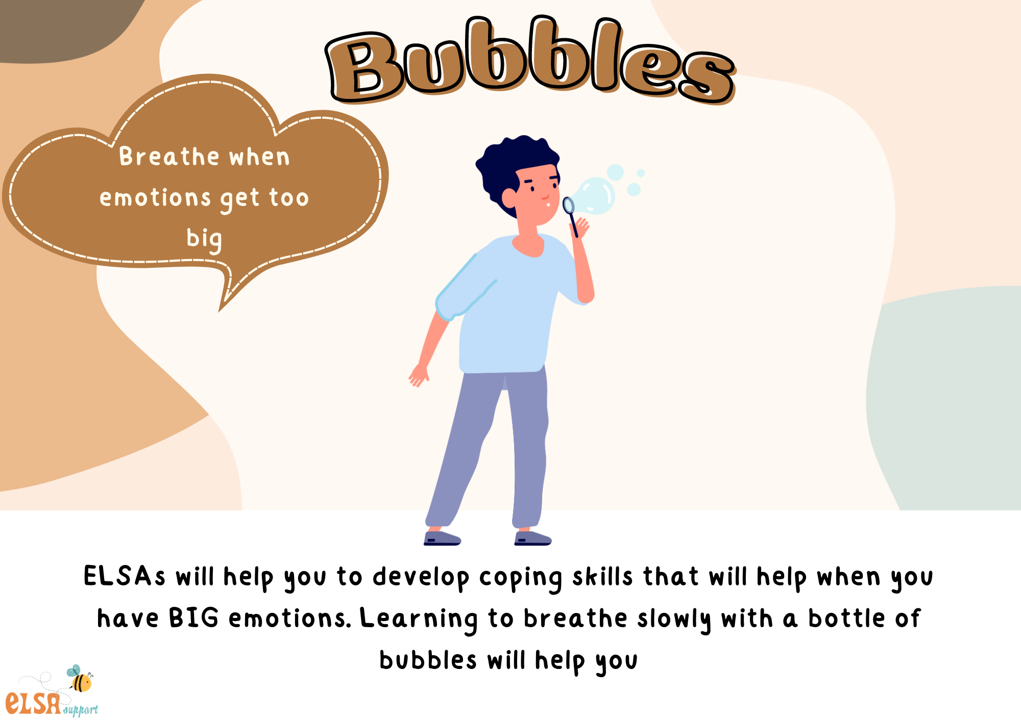

Slide 20
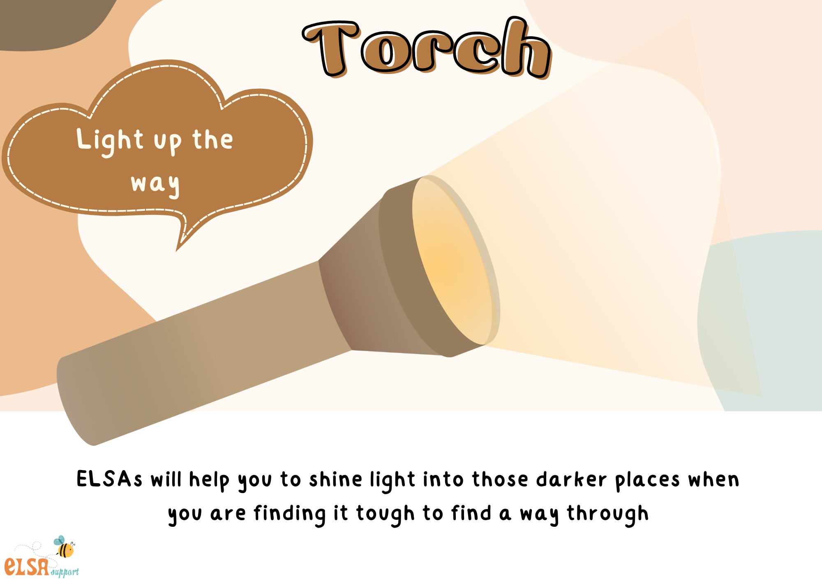

Slide 21
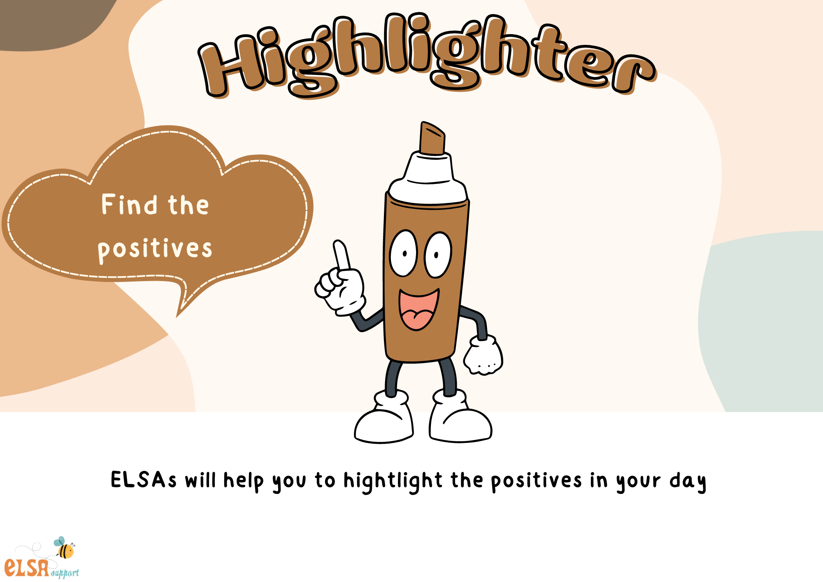

Slide 22
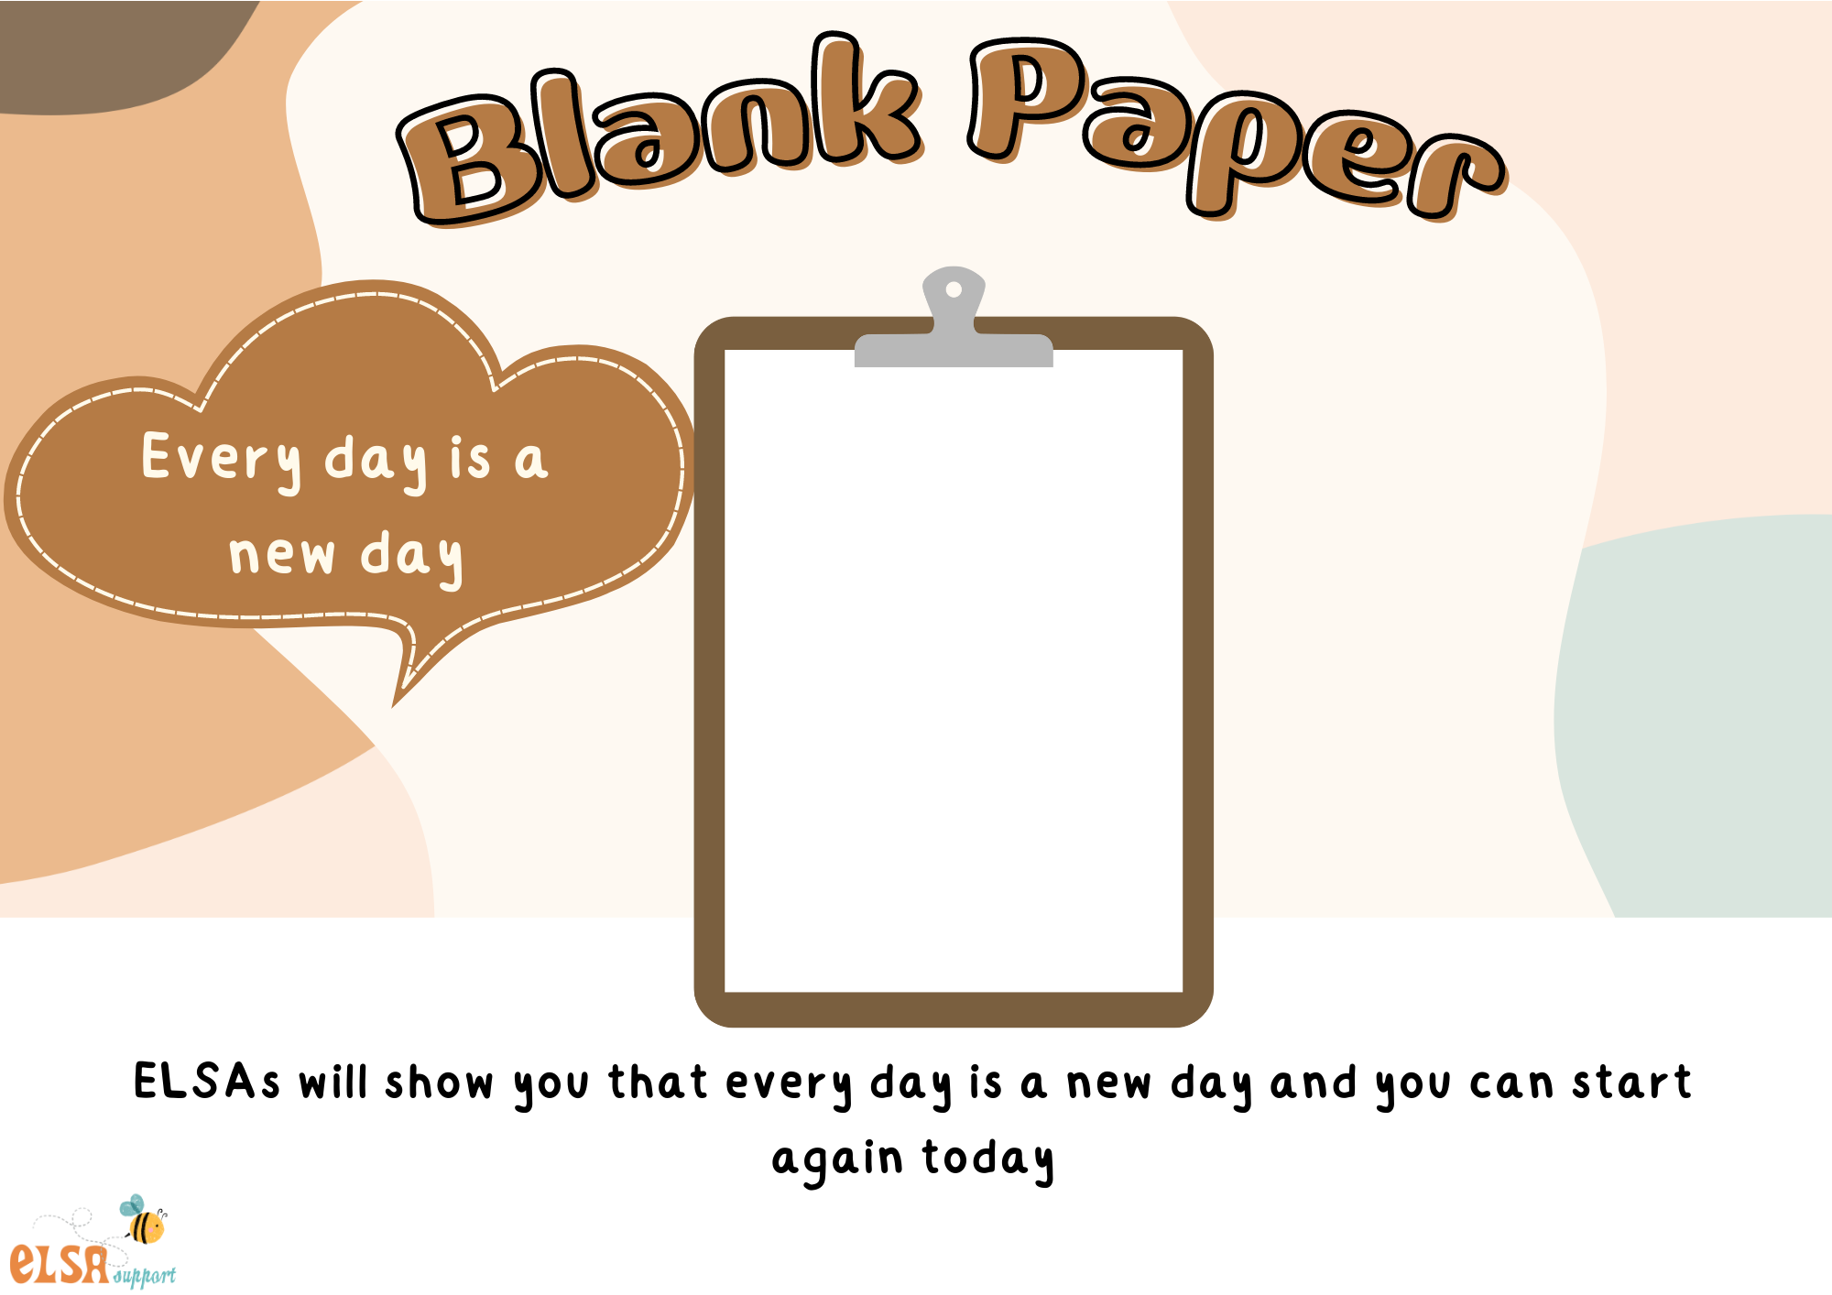

Slide 23
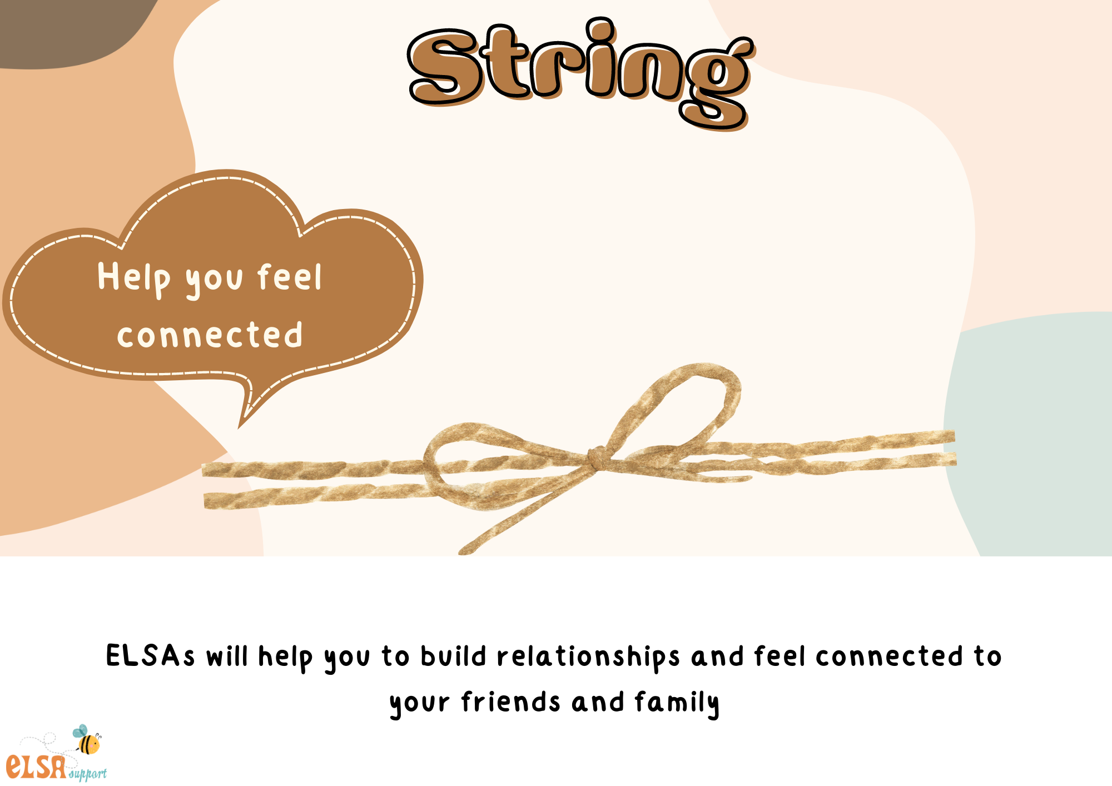

Slide 24


